Slide 1




Slide 2
Table QA
Notes:
Hello and welcome, in this video we will start to dive into the components of the internal structure of transformers.

Slide 3
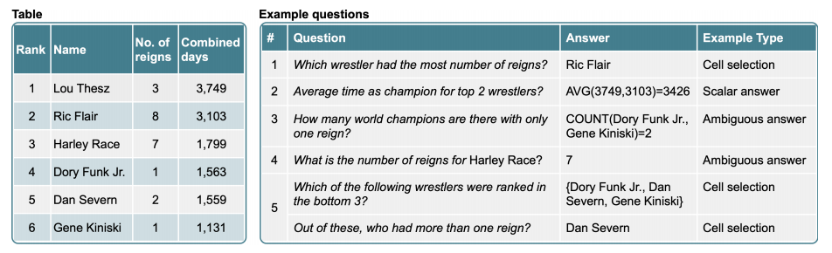
Introduction
Problem:
A lot of data, such as customer data within a company, is stored in structured databases instead of as raw text.

Slide 4
TAPAS Model
TAPAS model short for Table Parser.
It applies the Transformer architecture to tables by combining the tabular information with the query.
The TAPAS model is designed to understand and process tabular data, such as spreadsheets or structured databases.
Provide accurate responses to natural language questions related to the information present in the tables.
It utilizes a combination of pre-training and fine-tuning techniques to learn from large amounts of data, allowing it to generalize well to different table-based question-answering tasks.

Slide 5
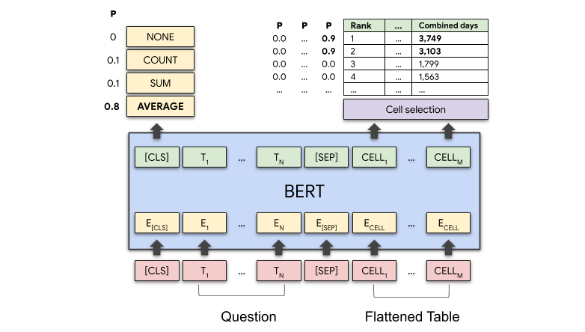
TAPAS Model
It’s a BERT-based model specifically designed and pre-trained for answering questions about tabular data.
TAPAS is pre-trained on the masked language modeling MLM objective on a large dataset comprising millions of tables from English Wikipedia and corresponding texts.
For question answering, TAPAS has 2 heads on top:
cell selection head
aggregation head, for optionally performing aggregations such as counting or summing among selected cells.
TAPAS has been fine-tuned on several datasets:
Sequential Question Answering by Microsoft SQA
Wiki Table Questions by Stanford University WTQ
WikiSQL by Salesforce.

Slide 6
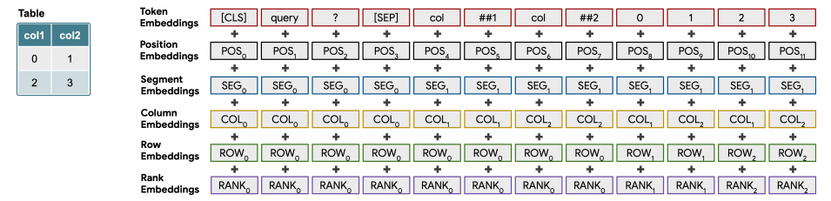
TAPAS relative position embeddings
TAPAS uses relative position embeddings and has 7 token types that encode tabular structure of data:
[CLS]: represents the classification token and is used to encode the beginning of the table.
[SEP]: The separation token indicates the boundary between different parts of the input, such as the table and the query.
[PAD]: The padding token is used to fill empty cells or make the table structure conform to a fixed size.
[COL]: column header It is used to encode the names or labels of the table columns.
[TYPE]: The type of token is used to indicate the data type of a column, such as "text", "number", or "date".
[CELL]: represents the content of a specific cell in the table. It encodes the actual values present in the cells.
[MASK]: The masking token is used during the pre-training phase of the TAPAS model. It helps the model learn to predict missing values in the table.
These token types, along with the content of the cells, column headers, and other contextual information, enable the TAPAS model to process and interpret the tabular data effectively.

Slide 7
How TAPAS works in practice?

Slide 8
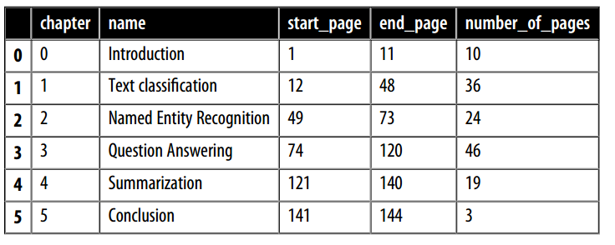
How TAPAS works?
Suppose you have this table as a data frame called table.

Slide 9

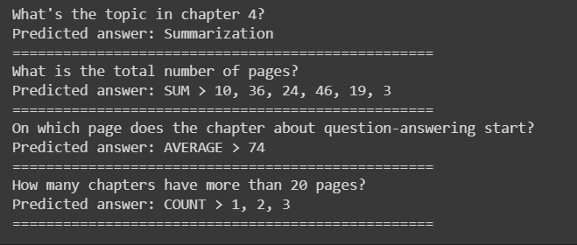
How TAPAS works?
Suppose you have this table as a data frame called table.
from transformers import pipeline
table_qa = pipeline("table-question-answering" )
queries = ["What's the topic in chapter 4?" ,
"What is the total number of pages?" ,
"On which page does the chapter about question-answering start?" ,
"How many chapters have more than 20 pages?" ]
preds = table_qa(table, queries)
for query, pred in zip(queries, preds):
print(query)
if pred["aggregator" ] == "NONE" :
print("Predicted answer: " + pred["answer" ])
else:
print("Predicted answer: " + pred["answer" ])
print('=' *50)
one cell with no aggregation
number of pages in combination with the sum aggregator
how many chapters have more than 20 pages we first need to find out which chapters satisfy that criterion and then count them.

Slide 10

How TAPAS works?
The ability to ask questions in natural language instead of Python code allows a much wider audience to query the data to answer specific questions.
Imagine such tools in the hands of business analysts or managers who are able verify their own hypotheses about the data!.

